Slide 1
HackerNEST—From Toronto to Seoul
By: Vicky Wang
June 7th, 2017

Slide 2

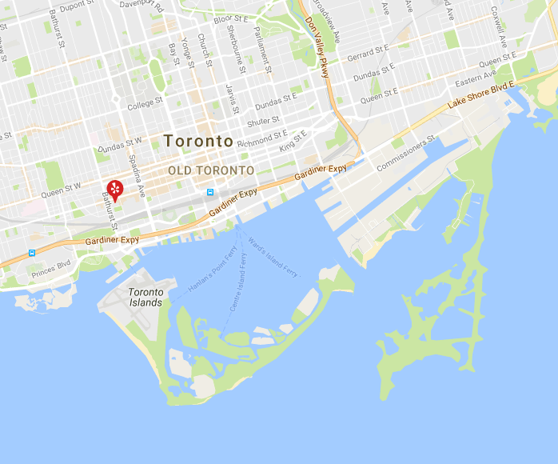
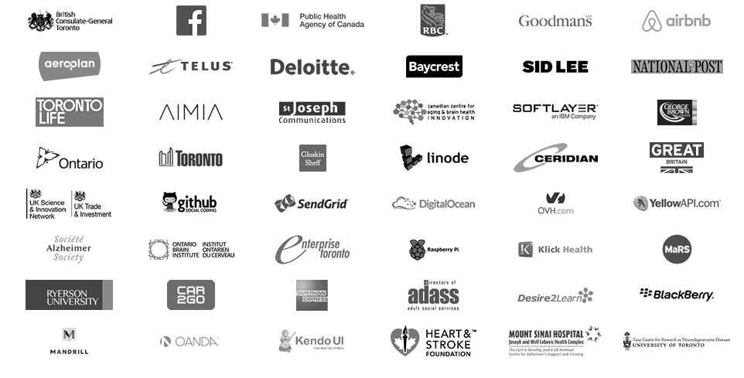
About Hackernest
Based in Toronto
Founded on January 11, 2011
Founded by 3 individuals with the goal of getting more people into technology
Now is a crown corporation
50 employees

Slide 3
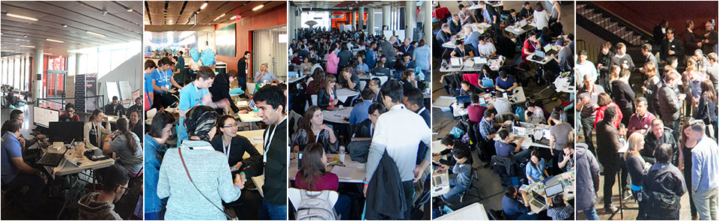
Hackathons and Tech Meetups
Notes:
HackerNest run 6-7 hackathons per year
Host up to 5 tech meetups monthly

Slide 4

HackerNest’s expansion
Subsidiaries are known as ”splinter cells’
Run over 250 events in 23 cities, 12 countries, 5 continents
In 2017, HackerNest should expand to Seoul, South Korea

Slide 5
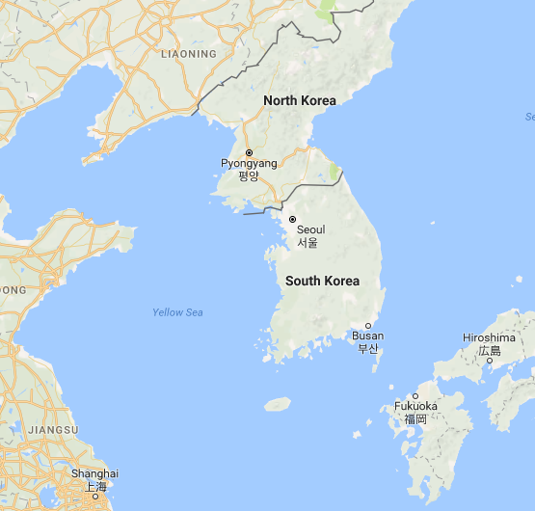
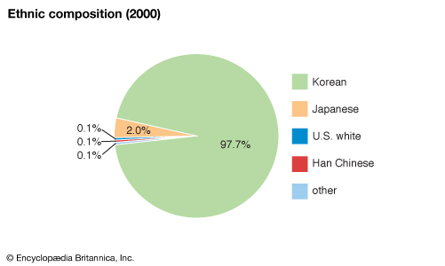
About SOUTH KOREA
East Asia
Population: 50.6 million
97% are ethnically Koreans
Official language: Korean
13 hours ahead of Toronto
Most wired country
Fast and Reliable postal service

Slide 6
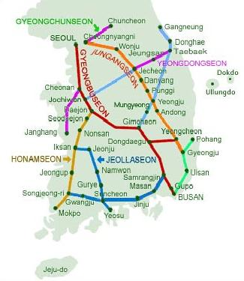
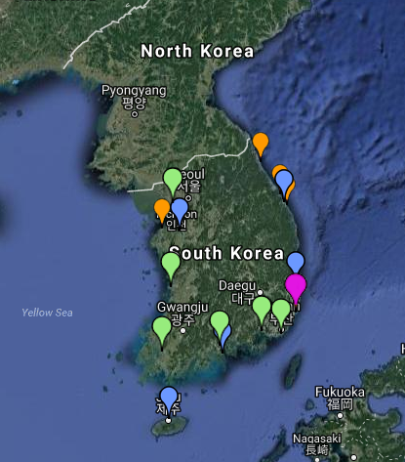
Transportation in south Korea
Train is the most convenient transportation between cities
Highway network serves all parts of South Korea
Shipping: primary way to import and export products
Operates one of the world’s largest merchant fleets
Rivers are crucial to transportation of goods
103 Airports

Slide 7
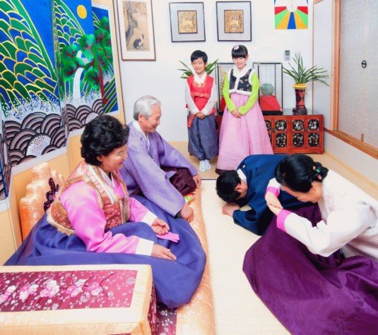
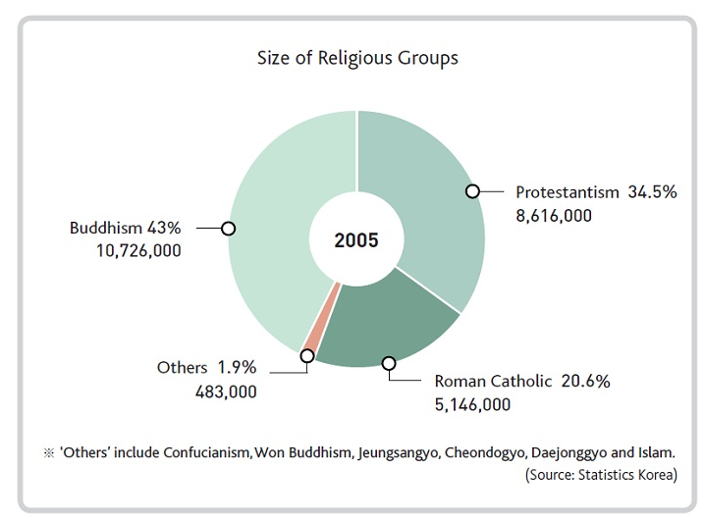
Culture in south korea
The Confucian value
The concept of “face”
Harmony in business and personal relationship
All religions are represented
Notes:
Confucian values: should respect authority, respect the collective, behave virtuously, work hard, avoid extremes, and live moderately
To prevent the loss of face, Koreans will avoid confrontation or will tell others what they want to hear rather than tackling issues head on
For example, rather than saying “no” to an employee, say “try it”.
Rephrasing the questions and answers in different ways will allow the business to maintain harmony in the relationship.
During a meeting or negotiation with a local business, HackerNest should be very respectful and mindful of others’ dignity

Slide 8
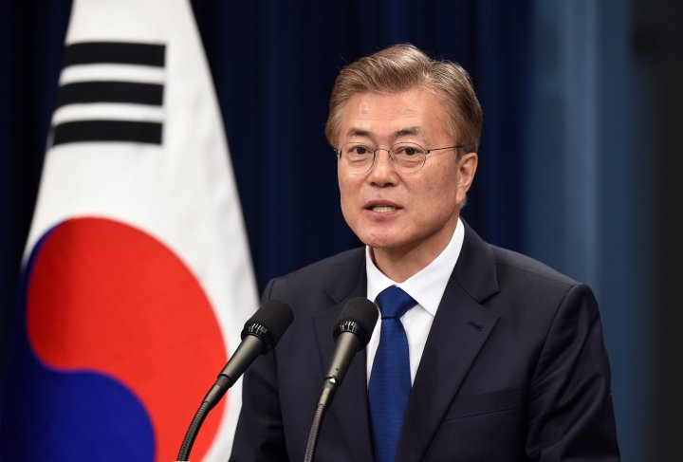
Politics in south korea
A liberal democratic political system
President: Moon Jae-in
A multi-party system
Unstable political situation
Corruption Perceptions Index: 53
52nd out of 176 nations
Notes:
The unstable political situation is due to the political scandal surrounded Park’s friend and informal adviser, who is accused for abusing of power and attempted fraud. Following claims stated that Park had access to secret government documents and intervened in state affairs. Due to the political scandal, president Park was impeached in December 2016

Slide 9
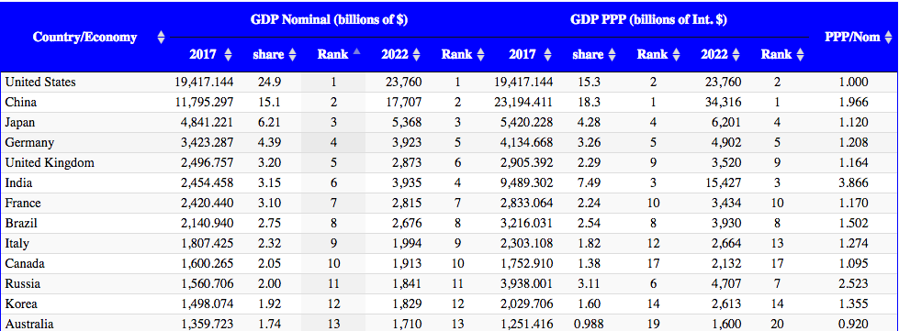
Economics in south Korea
One of the Asian Tigers
12th largest economy. Developed, mixed economy
Government encourages the growth of large, internationally competitive businesses
Global producer of automobiles, electronics, shipbuilding, steel, and high-technology product
Chaebol dominated economy

Slide 10
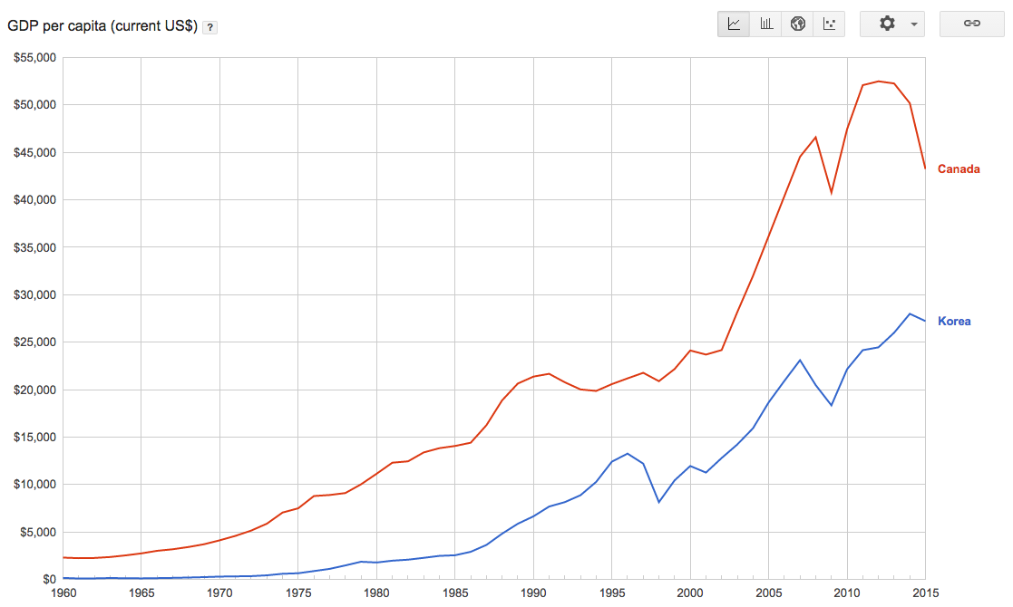
South KOREA VS. CANADA—gdp/capita

Slide 11
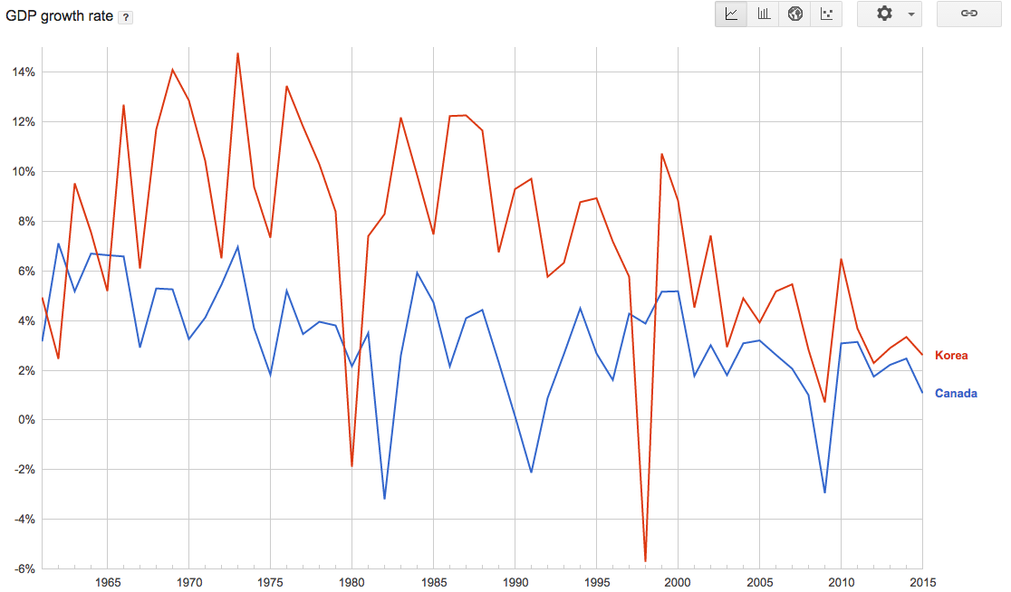
South KOREA VS. CANADA—gdp GROWTH

Slide 12
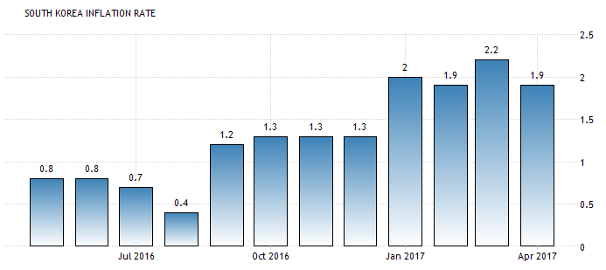
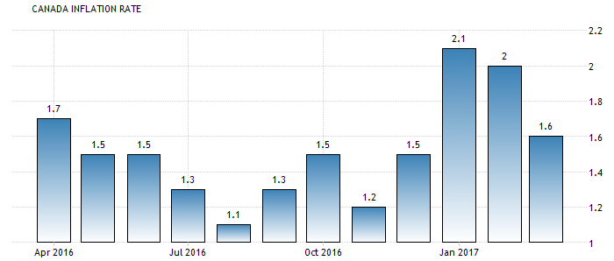
South KOREA VS. CANADA—Inflation

Slide 13
South Korea vs. cANADA—others
 | South Korea | Canada
Human Development Index | 0.90 | 0.92
Life Expectancy | 82 | 82
Unemployment Rate | 3.5% | 6.9%
Average Household Income | $19,400 | $76,000

Slide 14
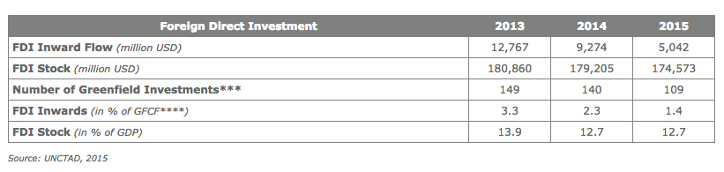
foreign direct investment in south Korea

Slide 15
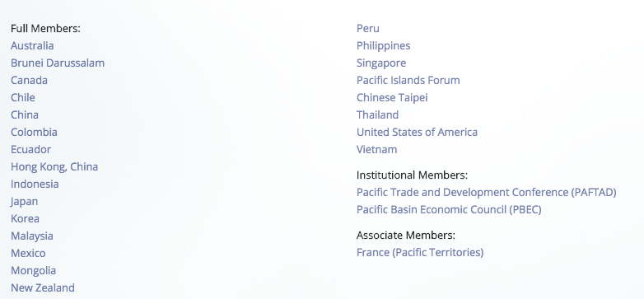
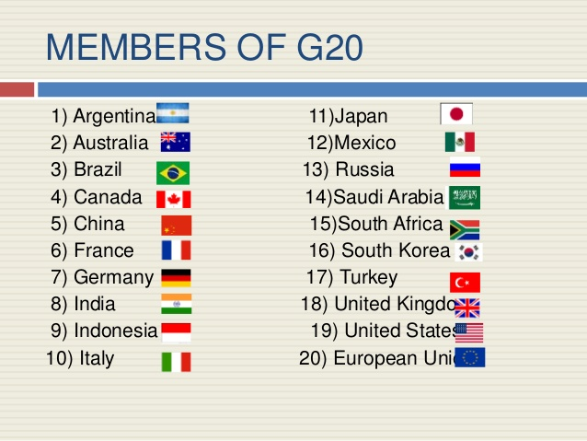
South Korea’s international relations
Diplomatic relations with 189 countries
Active member of United Nations, WTO, UNESCO, APEC, Pacific Economic Cooperation Conference, and the G20
Notes:
South Korea’s active engagement in various of international organizations will help HackerNest’s world expansion. HackerNest should partner with the local offices of those international organizations to gain trust and publicity.

Slide 16
Potential issues
Presidential Scandal
Re-election of president
Aging population
Dominance of chaebols
Heavy reliance on exports
Samsung leader’s arrestment
Notes:
President Moon has promised to reform South Korea’s chaebols. Since chaebols play a huge role in South Korea’s economy, there might be a potential economic growth or decline in the future

Slide 17
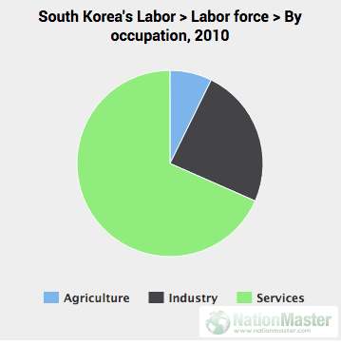
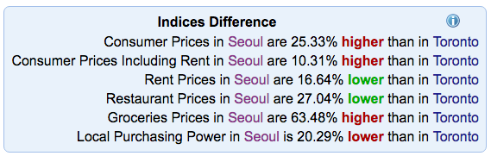
employment in South Korea
Labor Force: 25. 77 Million
Minimum Wage: 5.72 USD
Higher living index than Toronto
Max hour: 40 + 12
Notes:
The minimum wage differs greatly depending on occupation. HackerNest needs to hire engineers and high-tech specialists to set up and run hackathons. HackerNest should pay those employees with a yearly salary of anywhere between 30,000 USD to 62,000 USD
4000 USD to live in Toronto, this employee needs around 4400 USD in Seoul
should offer members of the executive board with higher salaries.
HackerNest should try not to exceed the maximum weekly working hours. If exceed, HackerNest should offer incentives to its workers

Slide 18
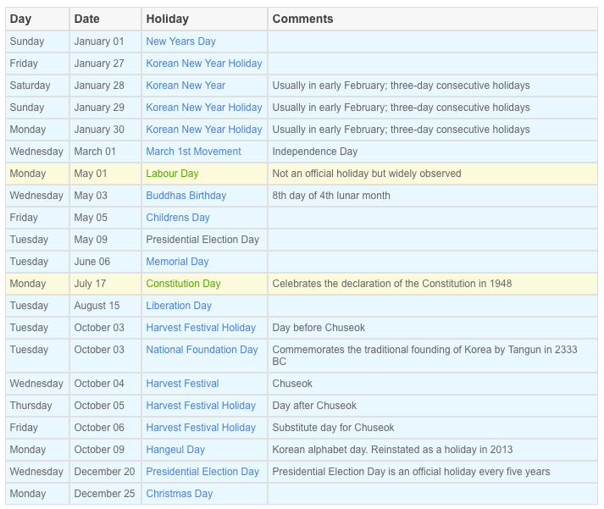
Holidays in South Korea
Notes:
The Ministry of Labour in Korea has implemented system in which workers who do not miss a day of work in one week receive one paid holiday. who do not miss a day of work in a full year are entitled to a 15-day paid vacation and an additional day for each two years of service.
HackerNest should expect its employees taking paid vacations during any time of the year.

Slide 19
Labor laws in south korea
Act on the Protection of Dispatched Worker
Child Labor Law
Workers subscribe to Industrial Accident Insurance against work-related accident, the Health Insurance, the Employment Insurance, the Retirement pension, and the National Pension Plans
Korea Occupational Safety and Health Agency
Occupational Safety and Health Act
Equal Employment Act
Notes:
Working condition
Minim working age—15
Regulate workspace safety
Prevent accidents and promote comfortable working environment
Gender equality
HackerNest needs to establish a management system for occupational safety and health, prepare preventative measures for harmful and dangerous equipment, and periodically provide employees with necessary safety and health education

Slide 20
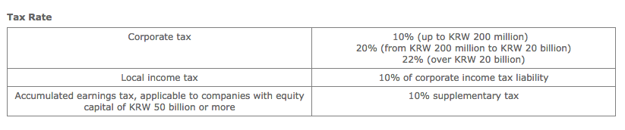
TAX in south Korea
Standard Corporate Income Tax
Taxed on Korean-sourced income
Taxation on capital gains
Double taxation treaty

Slide 21
Why South korea?
Canada-Korea Free Trade Agreement (CKFTA)
Specialization in new information and communication technology
Well-educated labor force
Government offers FDI support such as tax reduction and cash grants
A gateway for HackerNest to expand to other cities in the dynamic Asia-Pacific region
Notes:
CKFTA:
No tariff on any digital product or communication technology from Canada, HackerNest will not be charged with any tariff
promotes the use of internationally accepted standards, which minimizes duplicative certification and testing of services.
Provide HackerNest with access to information such as laws, regulations and administrative rulings
provides preferential access to Canadian professionals who work in the science, engineering or information technology fields—HackerNest will not face any problem sending help overseas
HackerNest will benefit from the talented individuals in South Korea. Individuals with an engineering or technology major can be hired as hackathon organizers or mentors. Job seekers with a business degree can be hired as accountants, consultants, managers, and secretaries. To reach out to more people and spread hackathon, HackerNest can consider accepting university-student volunteers to help organize tech socials and hackathons.

Slide 22
Why Seoul
Capital
Political, economic, cultural, and educational center
Locates on the Han River
Northwest
Population:10.29 million
Technology hub
Notes:
Many international and domestic business
Easy to find sponsors, venues to host hackathons and hack meetups.
Educational center—target market

Slide 23
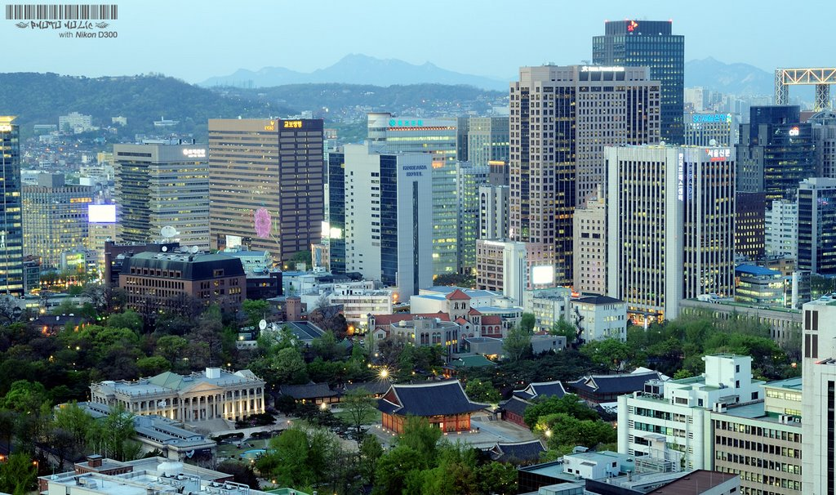
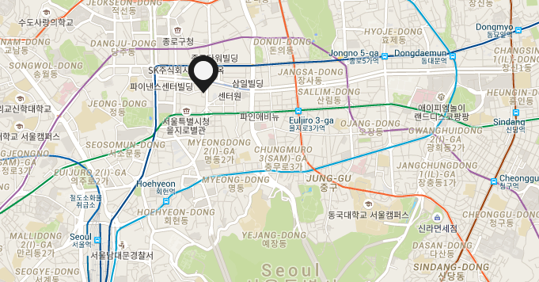
HackerNEST Office
Notes:
Central Business District.
centre of Seoul’s most successful business hub
has a modern and stylish atmosphere
direct access to subway station, subway connection to the Airport
it is close to the city hall, embassies, as well as international class hotels and restaurants –can accommodate foreign employers at nearby hotels

Slide 24
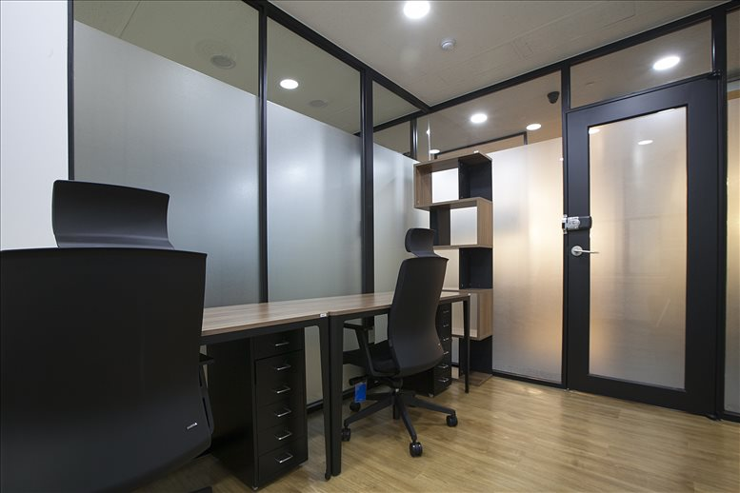
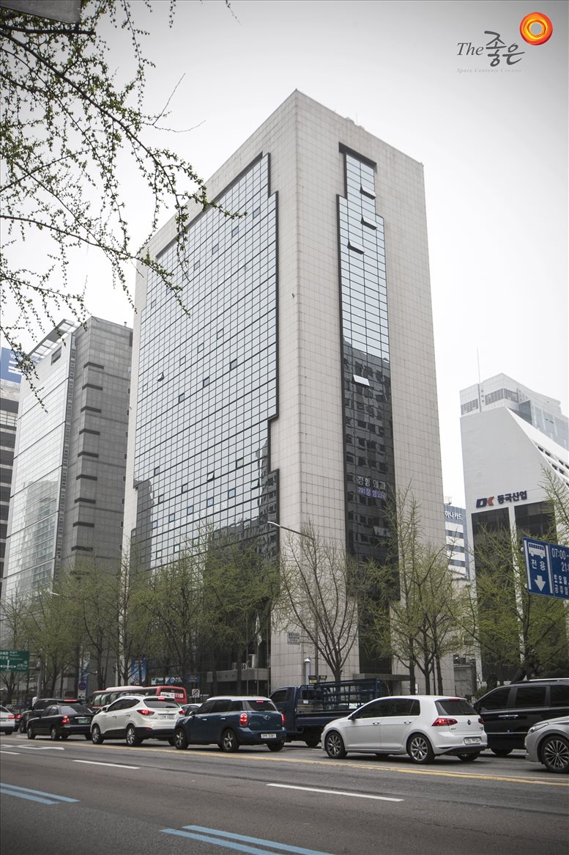
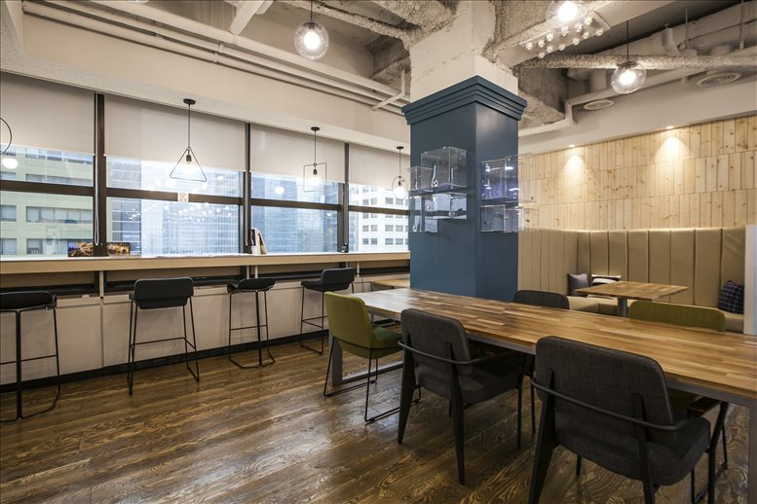
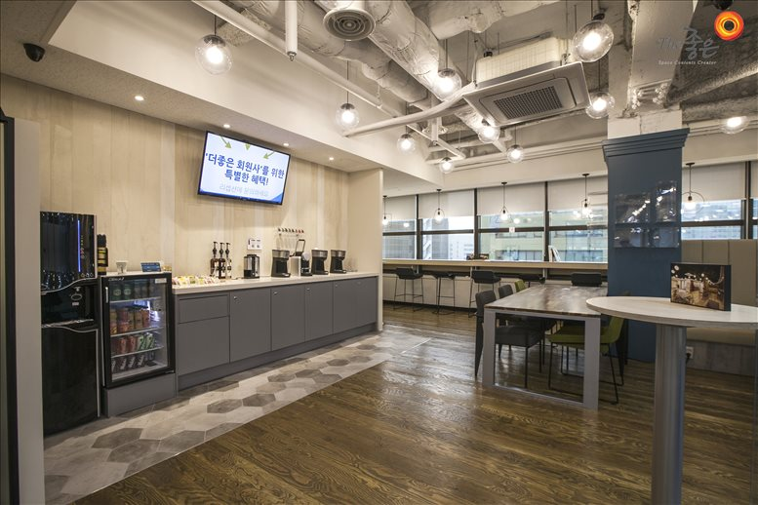
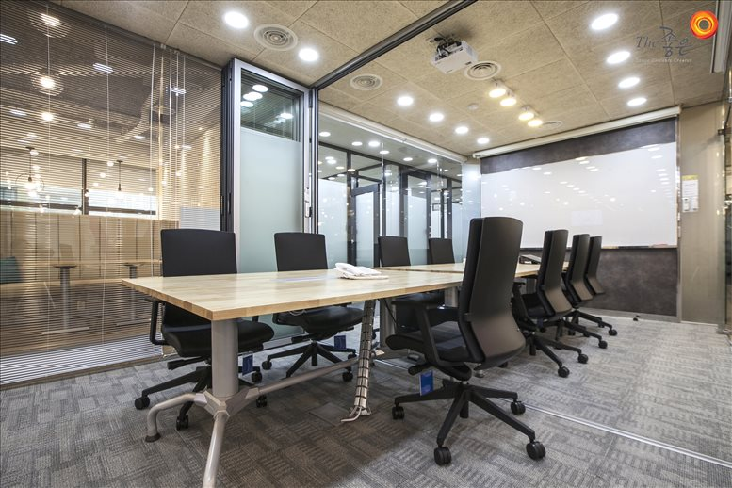
Hackernest OFFICE
$2500 USD
Notes:
6 office suites along with a spacious co-working space
conference rooms, business lounge, Wi-Fi, copying facilities, IT support, and videoconferencing equipment
videoconferencing equipment will be used
Lounge—tech meetups

Slide 25
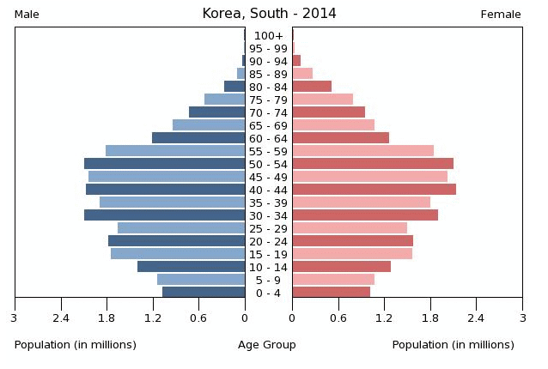
Target Market
Millennials
1.4 million people
Well-educated and well-informed
Concerned with brand name
Notes:
high-school students, college students, and people who entered the work force in recent years
consumers typically research products online, especially through social media
HackerNest should translate their official website into Korean, stay active on social media, and contact media and press to be featured online

Slide 26
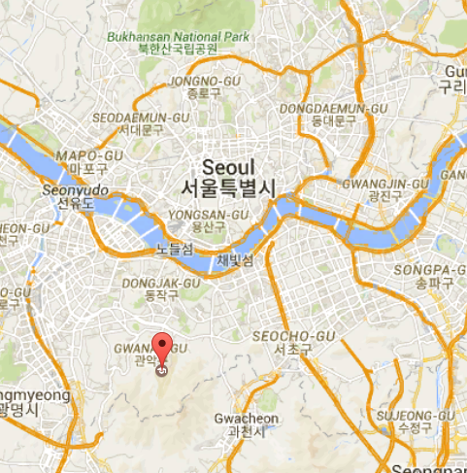
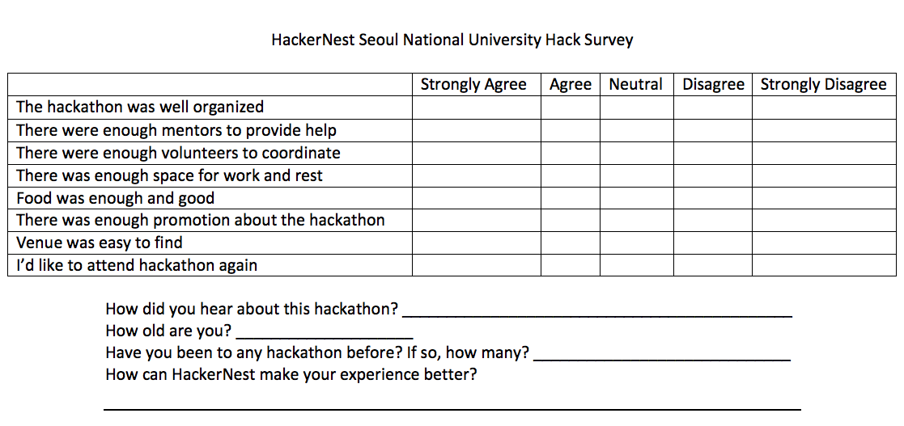
Primary Market Research
Hackathons:
Test market: Seoul National University
Likert Scale survey
Notes:
Market research must be conducted to solve marketing problems
For instance, HackerNest needs to know the issues that most South Koreans want to address at hackathons, what people like or dislike about HackerNest’s tech social and hackathons, and who is most interested in attending HackerNest’s tech social and hackathons
HackerNest can host a small-scaled hackathon that lasts 24 hours on campus and gather feedback from the attendants.
Because it is very expensive to conduct a test market research, HackerNest should ask Seoul National University for sponsorship
During the event, HackerNest should observe what the attendants enjoy the most and dislike the most
After the event, HackerNest can give each attendant, volunteer and mentor a likert scale survey to fill in

Slide 27
Primary Market Research
Tech Meetups:
Focus group research
For potential tech meetups attendants
Notes:
ask the focus group what they like or dislike about the tech socials they have been to
and what they want HackerNest to do to make their tech-social experience better.
HackerNest has experience with expanding the business overseas, HackerNest can also use its internal information sources

Slide 28
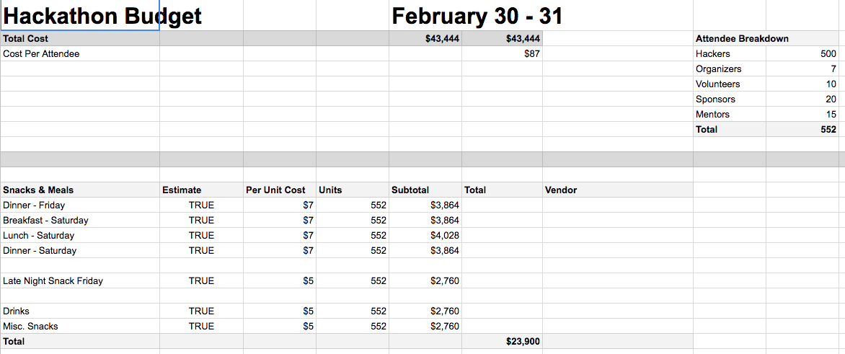
SECONDARY market Research
Major League Hacking Organizer Guide
Critical problems that the millennials care about
Notes:
HackerNest can use the Organizer Guide provided by Major League Hacking to organize hackathons
To allocate budget, HackerNest can refer to the “Template Hackathon Budget”
To determine the theme of each hackathon, HackerNest can research about the critical problems that the millennials care about
The top three concerning issue is are climate change and destruction of natural resources

Slide 29

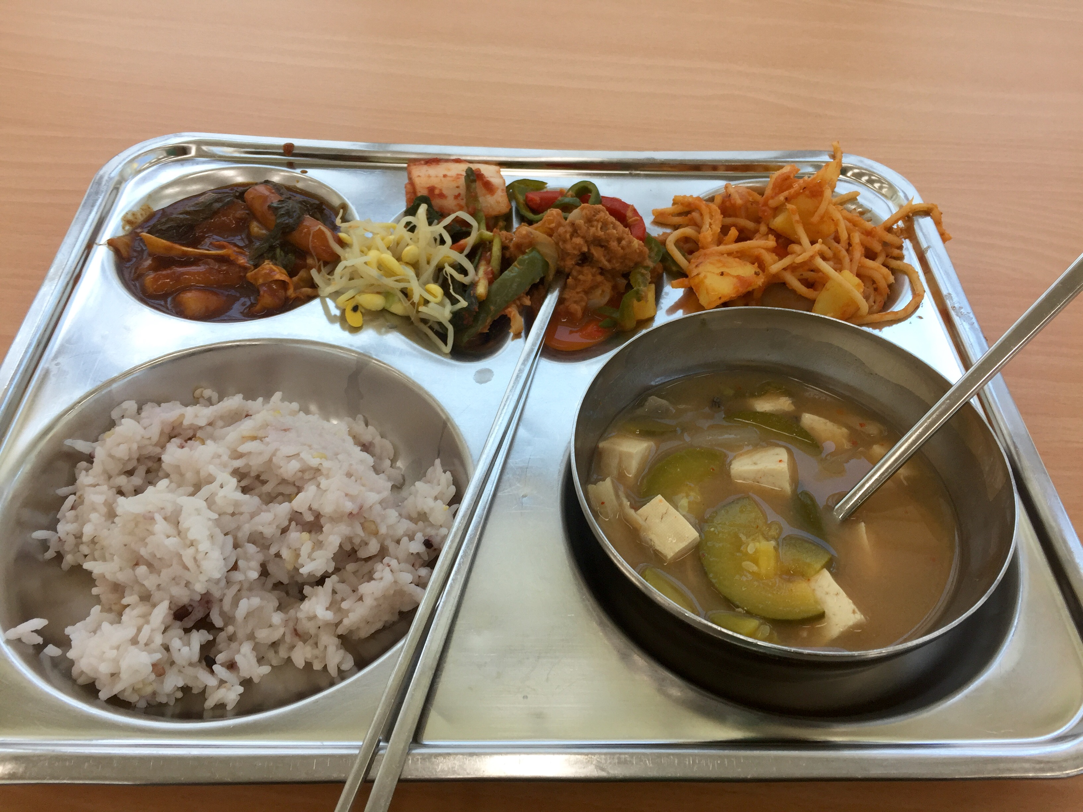
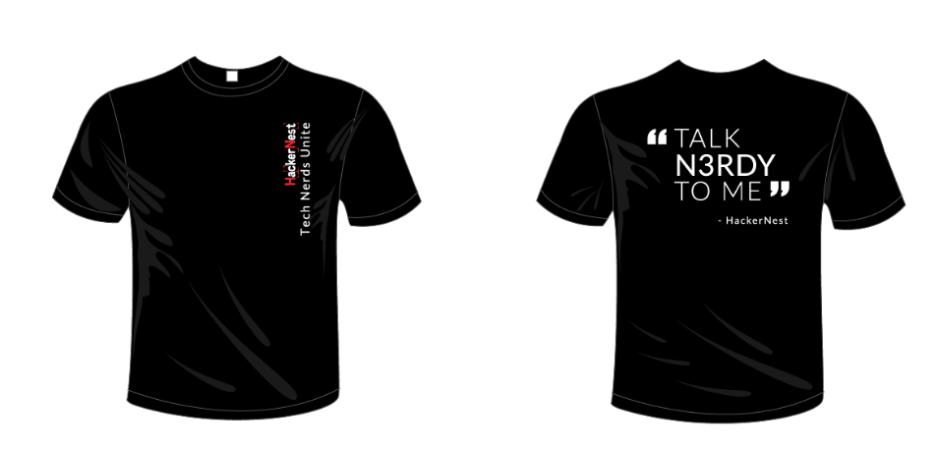
Hackathon
Environment Hack
36 hours
350 Korean participants
50 international participants
Invited video game celebrities
Invited judges from technology firms
Meals provided
Souvenir shirts
Notes:
This hackathon H
to tackle pressing environmental and natural challenges in South Korea.
can partner with the Ministry of Environment in South Korea and United Nation Environment Programme
HackerNest should reach out to video game celebrities because more than half of the population play online games regularly
Since Koreans love spicy food, spicy Korean food and kimchi must be provided. Rice, soup, and an addition of one meat dish, one vegetarian option, and one western dish should also be
South Koreans today seem to prefer thes inspired by modern western styles, HackerNest can use the shirt design from past hackathons and make few minor changes

Slide 30
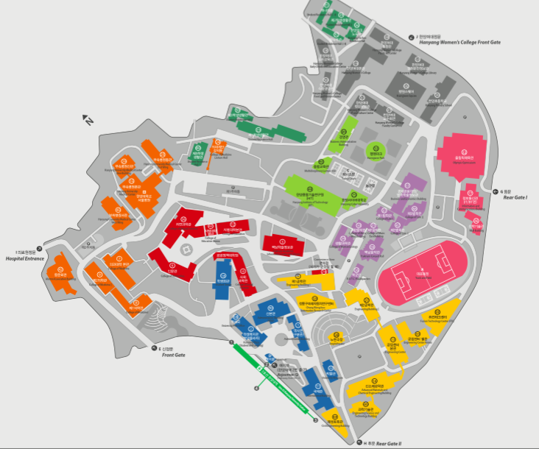
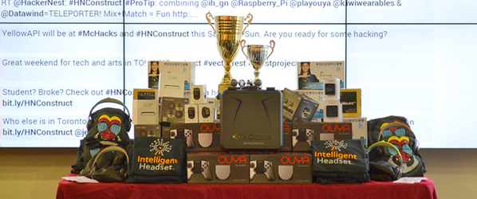
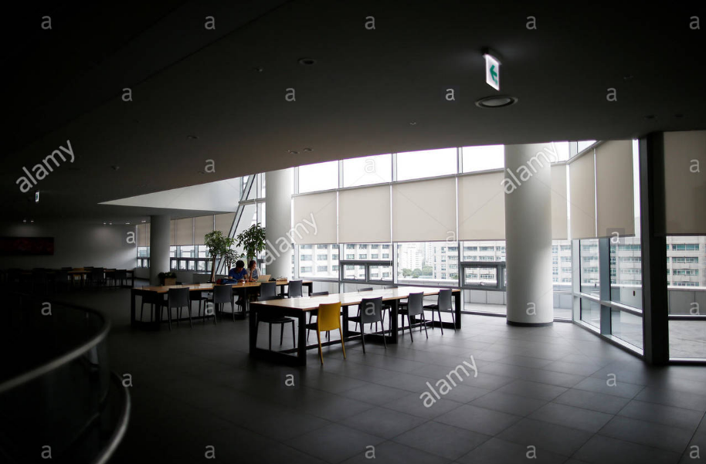
Hackathon
Prizes
Location: Hanyang University, Chung Mong-Koo Automotive Research Centre
Venue Checklist provided by Major League Hacking
Notes:
HackerNest can give out mentorship opportunities and IT products provided by sponsors
all prizes should be wrapped and branded with HackerNest’s and sponsors’ logos
should be wrapped in red, yellow, pink, or “Seoul Blue” as these colors denote luck and happiness
Prizes shouldn’t be given in multiples of 4 because number 4 is considered unlucky
Hanyang University locates in the heart of Seoul, the transportation to the venue is very convenient
This research centre is donated by Hyundai Motor Group to cultivate talent for the green and smart car the purpose of the hackathon shares some similarities with the mission of the research center.
has enough workspace, dining area, judging rooms, and resting area to accommodate over 400 people

Slide 31
Price and Sponsorship
Free to public
Hackathon budget: $45000 USD
Tech meetup budget: $500 USD
Notes:
HackerNest needs to fundraise and negotiate with IT businesses in Seoul.

Slide 32
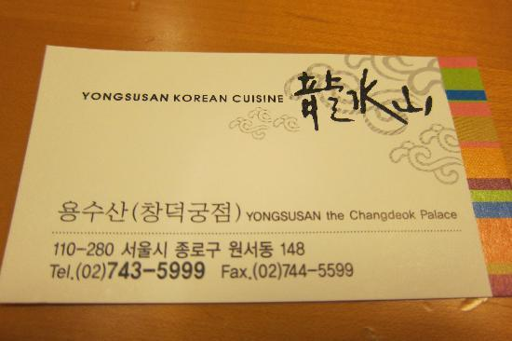
Negotiation Etiquette
Book meetings in advance
Be punctual
Show respect
The most common address in Korean is family name led by title
Business Cards
Slight bow and handshake
Should only expect to get to know the partner during the initial meetings
Following up meeting or negotiation
Notes:
Before approaching sponsors, HackerNest need to create a short info packet that explains what HackerNest does, and why HackerNest needs their sponsorship.
The top-down management structure in South Korean businesses reveals the importance of respecting authority.
The most senior person from HackerNest should enter the room first and greet the most senior representative of the other party.
Representatives of HackerNest should introduce older people to younger people and women to men.
for example “Professor Lee”
representative should be prepared to answer personal questions when they first meet a South Korean. This is because Korean businesses value hierarchy and the counterpart is trying to determine where the representative fits in the hierarchy.
it is customary to exchange business cards when meeting a business person for the first time
translated into Korean on one side, and when exchanging business cards, always remember to give out and receive it with both hands.
There is always tea or some type of drink offered during the meeting. It is impolite to refuse

Slide 33
Gift Giving
A tradition
Gifts should be wrapped
Gifts should be branded with logo
Notes:
Giving small gifts is part of the process of building a business relationship in South Korea.
South Koreans refuse the gift once or twice as a gesture of humility

Slide 34
Dinning Etiquette
Hierarchy and seniority
Utensils: Spoon and chopsticks
Alcohol might be offered
Key commercial information is revealed at the very end of a drinking session
Notes:
Hospitality is a part of South Korean business culture. HackerNest might be invited to dinner
If someone doesn’t want to drink, excuse himself or herself with medical or religious reasons.
it is polite to fill other people’s glasses first
key commercial information is revealed at the very end of a drinking session so HackerNest needs to be alert enough to catch the message.

Slide 35
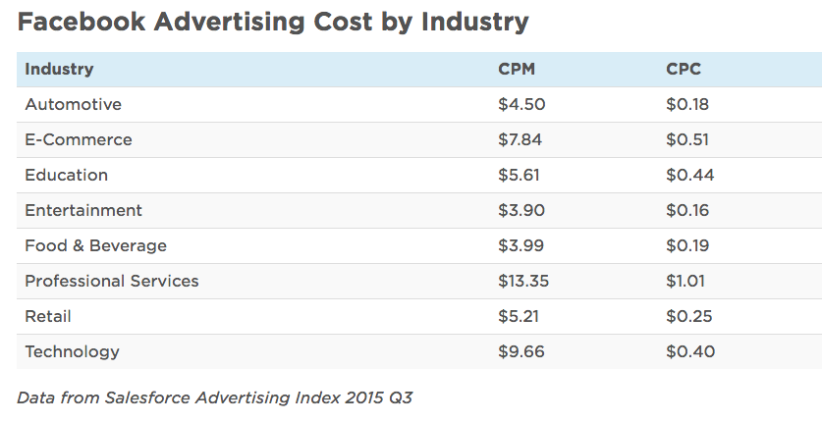
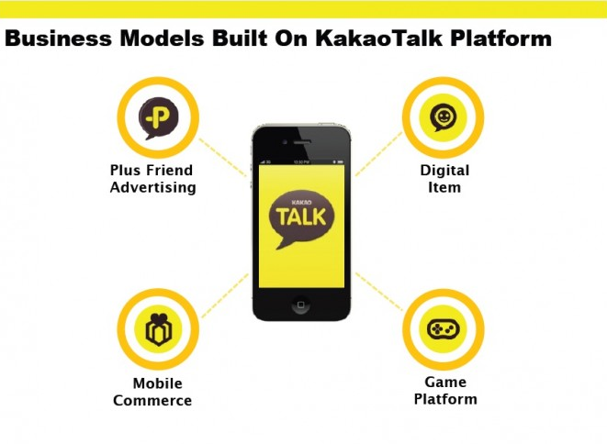
Promotion
Student group and STEM departments on campus
Social Media Campaign
Kakao Talk and Facebook
Cost: $0.40 per 1000 view
Notes:
creating a Facebook event page, as well as making a Kakao Talk business account
Facebook is the most popular social networking service and Kakao Talk is a free mobile messenger that is used by 35 million people
cost to advertise on Kakao Talk depends on many factors, such as the product, the target market, and the campaign goals
the targeting is low and many of the ads viewers might not be interested in hackathons or tech meetups

Slide 36
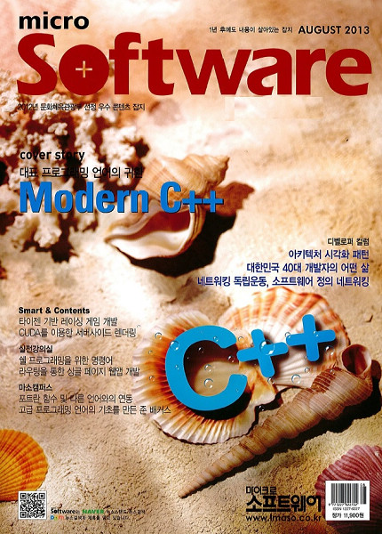
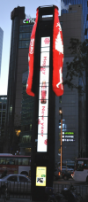
Promotion
Out-of-home advertising: Media Poles
Micro Software Magazine
Notes:
Media poles can attract a mass number of viewers at a time, and it doesn’t require special time for its audience to read. However, it is expensive and the ads cannot hit the target market directly.
Micro Software Magazine is a well-respected software development magazine in South Korea –best way
The target audience ranges from developers to student programmers—shares a similar market
The cost is $750 per issue.
HackerNest will get a full page color advert,

Slide 37
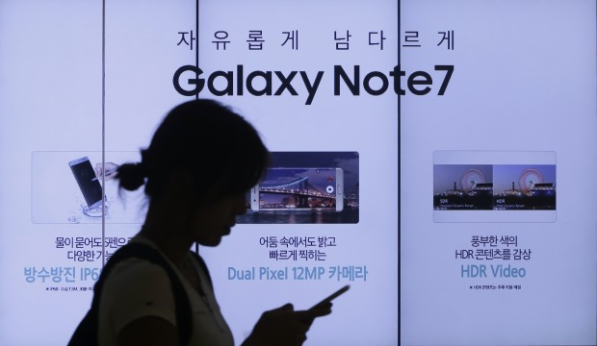
Ads Regulation
Use of Foreign Languages in Advertisement
Must be translated to Korean
Contain HackerNest’s or event’s logo
A catchy slogan of the event
Notes:
colorful and appealing pictures
a link to the Facebook event page

Slide 38

Direct Competition
Seoul Tech Community
Based in Seoul
Better reputation
Lack of well-known sponsors
Global Hackathon Seoul
Many sponsors
Notes:
an international non-profit organization that aims to build and unite tech community around the world
holds monthly tech meetups for people to collaborate on tech projects and host conferences for developers to share knowledge
HackerNest should utilize social media and press to gain public attention
HackerNest has been sponsored by many large-scale and well-known organizations and IT companies
HackerNest should list their sponsors on their advertisements.
In 2015, this organization planned a four-day long hackathon that attracted 2000 hackers across the world
airline tickers and hostel accommodation for all attendees would be fully sponsored.
Hackathon was cancelled due to spread od disease. Sponsors pull out, gained a dishonor
HackerNest should learn from Global Hackathon Seoul’s lesson and prepare for a backup plan for every hackathon.

Slide 39

Indirect competition
Seoul Global Startup Centre
Supports foreign entrepreneurs
Strong employees
Active on social media
Notes:
supports foreign entrepreneurs to begin their startup journey in Seoul. In the past year, SeoulGSC helped launch four foreign tech startups
SeoulGSC is only targeted to teams that have a ratio of at least 33% foreign residents of Korea in the co-founding team.
teams have to apply to become a member and the selection process is prestige
HackerNest should give everyone the opportunity to attend tech meetups and hackathons. When selecting hackathon participants, the judges should not only consider applicants’ background and expertise, but also their potentials and interests.

Slide 40
Thank you

